Slide 1
Breast Cancer Image Retrieval
CS60092

Slide 2
CS60092
Team Members
Name | Roll No | Contribution
D G Pranathi | 19CS10025 | Wrote the necessary code and scripts to carry out the experiments. Tested and validated the code to ensure accuracy and reliability of results. Analyzed the data obtained from the experiments to draw meaningful conclusions.
Sonu Kumar Yadav | 20CS10061 | Conducted thorough research on the assigned topic Helped Bhagoti in Report making. Ensured that the report adhered to the guidelines of the ARR format
Bhagoti | 20CS30010 | Conducted thorough research on the assigned topic Gathered information from reliable sources Compiled the findings into a well-structured report
Notes:
We are team of four members and each one will be presenting their corresponding contents

Slide 3
AI60201
PROBLEM STATEMENT
DATASET
LITERATURE SURVEY
SOTA MODEL &
IMPLEMENTATION
IMPROVEMENTS

Slide 4

PROBLEM STATEMENT

Slide 5
CS60092
Content Based Medical Image Retrieval (CBMIR) is a technique to retrieve relevant images by comparing the features contained in the query image with the features contained in the image located in the database.
Evaluation is done at two different class levels
Main-Class Category ('benign', 'malignant')
Sub-Class Category
Benign ('tubular_adenoma', 'phyllodes_tumor', 'fibroadenoma', 'adenosis')
Malignant ('papillary_carcinoma', 'mucinous_carcinoma', 'lobular_carcinoma', 'ductal_carcinoma')
Notes:
Compare feature vector with available ones in the json file

Slide 6
DATASET

Slide 7
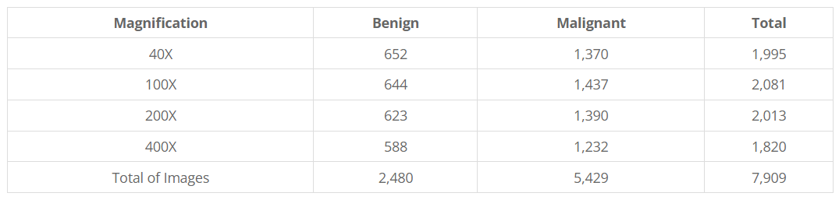
AI60201
BreakHis Dataset:
The Breast Cancer Histopathological Image Classification (BreakHis) is composed of microscopic images of breast tumor tissue collected from 82 patients using different magnifying factors (40X, 100X, 200X, and 400X). To date, it contains 2,480 benign and 5,429 malignant samples (700X460 pixels, 3-channel RGB, 8-bit depth in each channel, PNG format).
Notes:
RGB image of size 700*460

Slide 8
LITERATURE SURVEY

Slide 9
CS60092
CNN-Based Autoencoder Application in Breast Cancer Image Retrieval
Aims to utilize the CNN-based Autoencoder method to minimize misinformation in the feature extraction process and to improve the performance result, especially in the subclass dataset category.
original image in this study will be converted into a reconstructed image by utilizing the CNN-based Autoencoder method through the 2 stages of encoder and decoder.
Proposed a 3 stage method for Breast Cancer Image Retrieval
Training: Training Autoencoder to learn features of Microscopic images
Feature Extraction: performed by applying the best stored model in the previous training stage through the encoder stage in the Autoencoder model. The results of the feature extraction are further indexed into a .json (JavaScript Object Notation) file.
Retrieval: Upon successfully extracting features for new images, the calculation is performed between the similarities between the features in the image in the test data and the features of the image in the training previously indexed in the .json file.

Slide 10
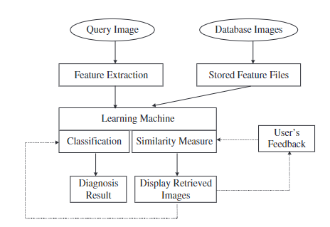
CS60092
Microcalcification classification assisted by content-based image retrieval for breast cancer diagnosis
Proposed a mammogram retrieval system involves two major components:
retrieving similar mammogram images from a database by using learning based similarity measure
classifying the query mammogram image based on retrieved results (retrieval-driven classification)
Proposed a retrieval-driven approach with an adaptive SVM (Ada-SVM) for improving the classification performance.
Introduced Cascade SVM to further reduce complexity of Ada SVM classifier
similar cases to a query sample are retrieved according to a similarity measure
if all these similar cases have the same class label, simply assign the same label to the query
otherwise, we invoke the Ada-SVM classifier

Slide 11
CS60092
Breast cancer diagnosis using image retrieval for different ultrasonic systems
Mammography and ultrasonography are the most frequently used tools for early diagnosis of breast tumors. the ultrasound (US) examination is more convenient and safer than mammography in daily clinical practice
To avoid unnecessary biopsy and improve the accurate of diagnosis, computer-aided diagnosis system can be a second beneficial support for physician to diagnose.
Using breast ultrasound pictures, a neural network classifier can distinguish between benign and malignant tumors. To distinguish between benign and malignant tumors, the texture variation in ultrasound images is a useful characteristic.
Natural langauge is time consuming so performed the image retrieval scheme by using the auto covariance coefficants to distinguish malignant from benign in the breast ultrasound images.
The principal component analysis (PCA) is used by the suggested CAD system to reduce the feature vector's dimension. The PCA has been used in applications for picture compression and content-based image retrieval. Using the PCA method, the textural feature vector can be converted into a smaller dimension. .

Slide 12
CS60092
Breast cancer diagnosis through active learning in content-based image retrieval
The most useful data points are chosen to be labeled using the active learning technique, and the model is then trained using those labels. Active learning can be used to choose the most instructive images to label and contribute to a database in the context of diagnosing breast cancer. By concentrating on the images that are most important for the detection of breast cancer, this can increase the CBIR system's accuracy.
The process of using active learning in content-based image retrieval for breast cancer diagnosis
Collecting a dataset of breast cancer images: The dataset should contain a range of images of healthy breast tissue, benign tumors, and malignant tumors.
Feature extraction: Image features such as texture, shape, and color are extracted from the images.
A CBIR system is built using the extracted image features to retrieve similar images from the dataset.
Labeling images: A small set of images are manually labeled as healthy or malignant.
Active learning: The CBIR system is used to select the most informative images for labeling based on their similarity to the existing labeled images. These new labeled images are added to the dataset and used to retrain the CBIR system.
Testing and evaluation: The accuracy of the CBIR system is evaluated using a separate test set of breast cancer images.

Slide 13
CS60092
MARRow (Multiple Active learning-based Retrieval of informative features for Robust diagnosis of breast cancer) is a proposed approach for breast cancer diagnosis using active learning in content-based image retrieval. The approach aims to improve the accuracy and robustness of breast cancer diagnosis by integrating multiple active learning-based retrieval techniques. Approach—
Image acquisition: Medical images such as mammograms, MRIs are acquired from patients.
Feature extraction: Relevant features are extracted from the medical images using techniques such as texture analysis, shape analysis, and edge detection.
Active learning-based retrieval: The extracted features are used to train a retrieval model using active learning techniques such as uncertainty sampling, query-by-committee, and density-weighted methods. The trained model is then used to retrieve informative features from new medical images.
Diagnosis: The retrieved informative features are used to diagnose breast cancer using classification models such as Support Vector Machines (SVM), Random Forests (RF), and Convolutional Neural Networks (CNN).
Feedback: The results of the diagnosis are fed back into the active learning-based retrieval model to update the model and improve its accuracy and robustness.

Slide 14
CS60092
A texture features-based medical image retrieval system for breast cancer
The system typically starts with preprocessing steps to enhance and normalize the image data. Then, texture features such as gray level co-occurrence matrix (GLCM), gray level run length matrix (GLRLM), and gray level size zone matrix (GLSZM) are extracted from the image. These features can capture the spatial distribution of pixel intensities and provide a quantitative representation of the texture properties of the image.
Next, a retrieval algorithm is applied to compare the texture features of the patient's image with those in a database of previously diagnosed cases. The algorithm can be based on similarity metrics such as Euclidean distance, Mahalanobis distance, or cosine similarity. The retrieved images are then presented to the radiologist for further analysis and diagnosis.
Texture features based medical image retrieval system for breast cancer can provide a valuable tool for radiologists to support diagnosis and improve patient outcomes.

Slide 15
SOTA APPROACH & IMPLEMENTATION

Slide 16
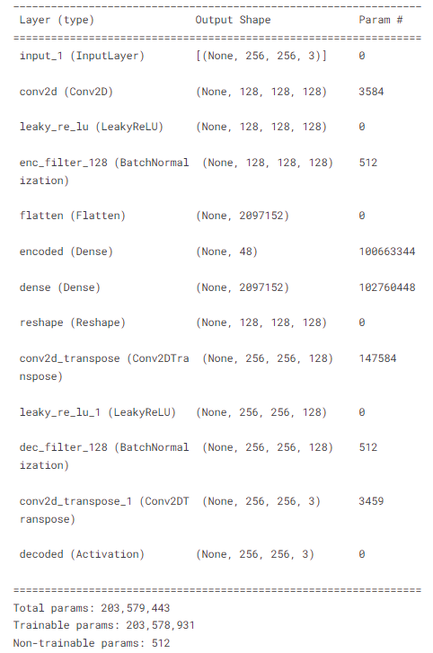
CS60092
SOTA Approach:
“CNN Based Autoencoder Application in Breast Cancer Image Retrieval” is currently the SOTA model for Breast Cancer Image Retrieval on BreakHis Dataset.
There are mainly 3 stages in this approach
Autoencoder Training
Feature Extraction
Retrieval process and Evaluation
Evaluation is done on
Class Level (Main, Sub Classes)
Magnification Level (40X, 100X, 200X, 400X)
Notes:
CNN Based Autoencoder is currently State of the art model for Breast Cancer Image Retrieval.
As mentioned in literature survey there are s stages in this approach (Training, Feature Extraction and Retrieval).
Finally evaluation is done at 2 levels (Class level which involves main class and subclass categories and magnification level that involves 4 different magnification images).
Right image shows the Autoencoder model. Model has encoder and decoder.
Encoder contains a Convolutional layer followed by a activation and batch norm. Output is flattened and passed through a Fully connected layer to get 48 dimensional vector. This is passed to decoder which has a Fully connected layer followed by Conv Transpose layers.

Slide 17
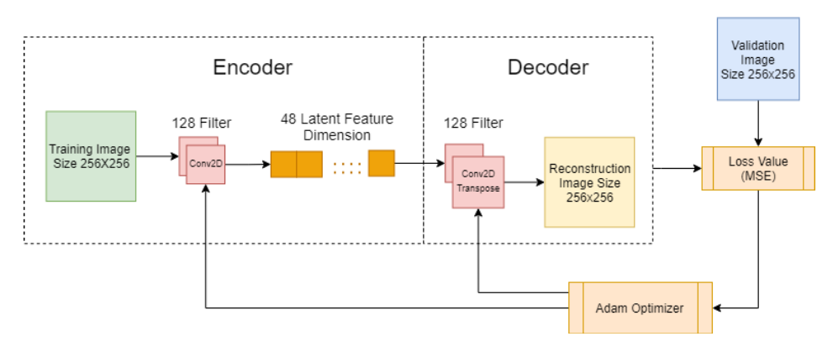
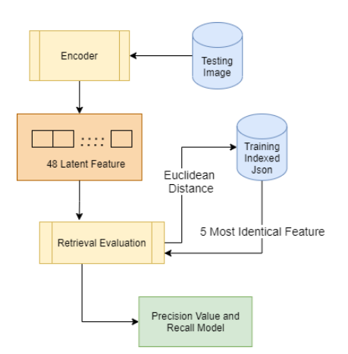
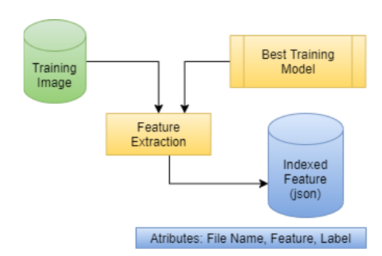
CS60092
Training
Retrieval
Feature
Extraction
Notes:
These are illustrative images for 3 stages mentioned in previous slide.
First we train the Autoencoder and save feature vectors of all the training images in a JSON file along with their labels
For a new test image, we will pass it to encoder to get feature vector. This feature vector is compared with training data feature vectors using euclidian distance metric.

Slide 18
CS60092
Implementation:
Integrated both main-class and sub-class categories tasks into a single script.
Training Specs:
GPU T4x2 (Kaggle Notebook)
TensorFlow Framework
Input Image size: (256x256x3)
MSE Loss
Adam Optimizer
Epochs: 20
Data split: 80:10:10
Batch size: 16
Notes:
Official code has different scripts for main-class and sub-class tasks. We integrated both the scripts into a Kaggle notebook and ran the experiments.
Data is split into 80:10:10 ratio for training, validation and testing and images are resized to 256x256x3 and a batch size of 16 is used
Trained the model on GPU for 20 epochs using Mean squared error loss and Adam optimizer

Slide 19
CS60092
Results
MainClass Category:
Magnification | Precision | Recall
40X | 0.933 | 0.793
100X | 0.924 | 0.771
200X | 0.973 | 0.846
400X | 0.945 | 0.770
Notes:
These are the results for Main class category

Slide 20
CS60092
Results
SubClass Category:
Magnification | Precision | Recall
40X | 0.689 | 0.422
100X | 0.635 | 0.319
200X | 0.595 | 0.325
400X | 0.560 | 0.251
Notes:
These are the results for Sub class category

Slide 21
IMPROVEMENTS

Slide 22
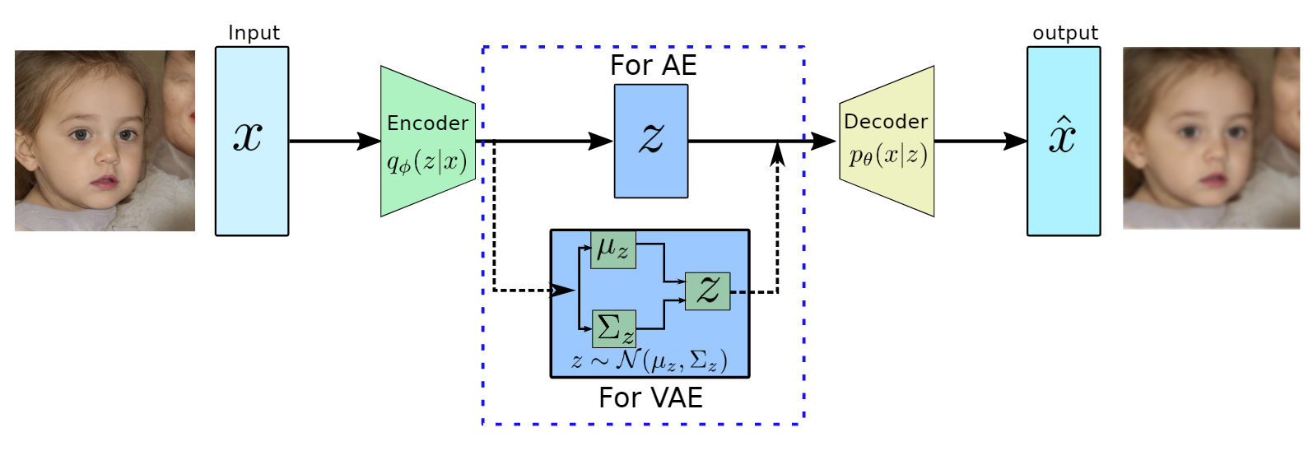
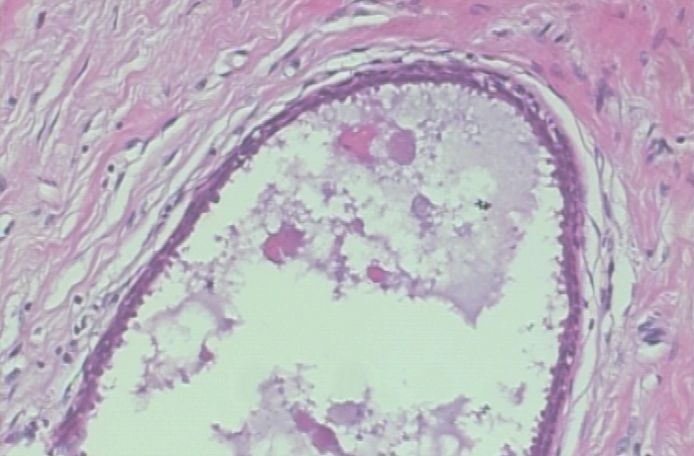
CS60092
Using VAE model in place of the Autoencoder as a regular AE has huge gaps in possible input values to the decoder, but a VAE has fewer input value gaps.
Notes:
Replacing Auto Encoder model with Variational Autoencoder
VAEs uses Kullback-Leibler (KL) divergence loss whereas AE uses MSE Loss, KL Divergence encourages the learned latent space to follow a Gaussian distribution. This helps in preventing overfitting and encourages the model to learn meaningful representations of the data.

Slide 23
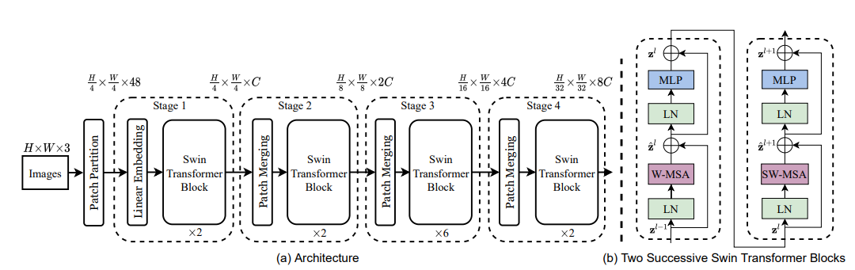
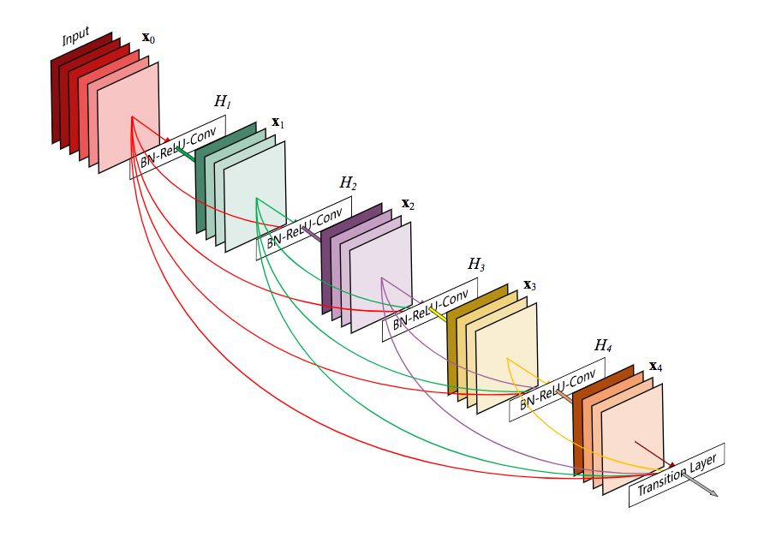
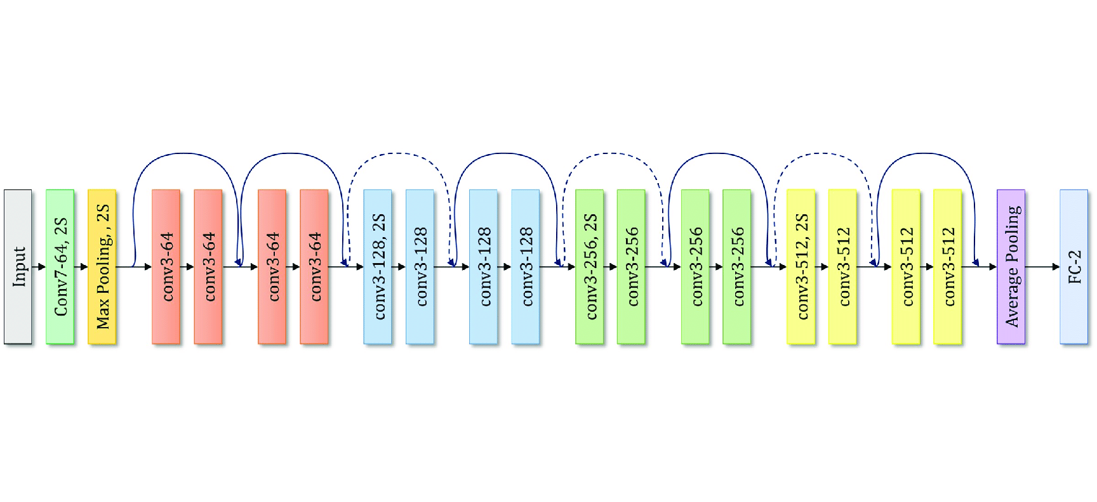
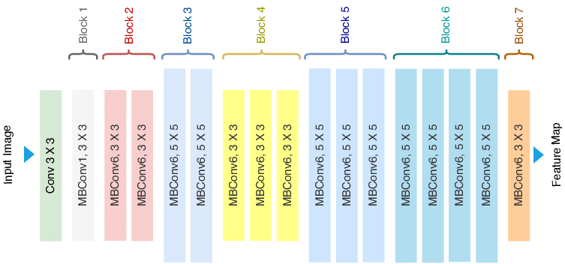
CS60092
Replacing current encoder with SOTA Image Classification models as encoders
Swin Transformer
DenseNet
EfficientNet
ResNet
Notes:
Current encoder has only one Conv layer and to increase complexity we replaced the current encoder with state of the art image classification models like Swin, DenseNet, EfficientNet and ResNet
To match the complexity of encoder and decoder we increase the number of layers/stages of Conv Transpose + Upsample Layers from 1 to 6 in decoder to have comparable model complexity (no of parameters).

Slide 24
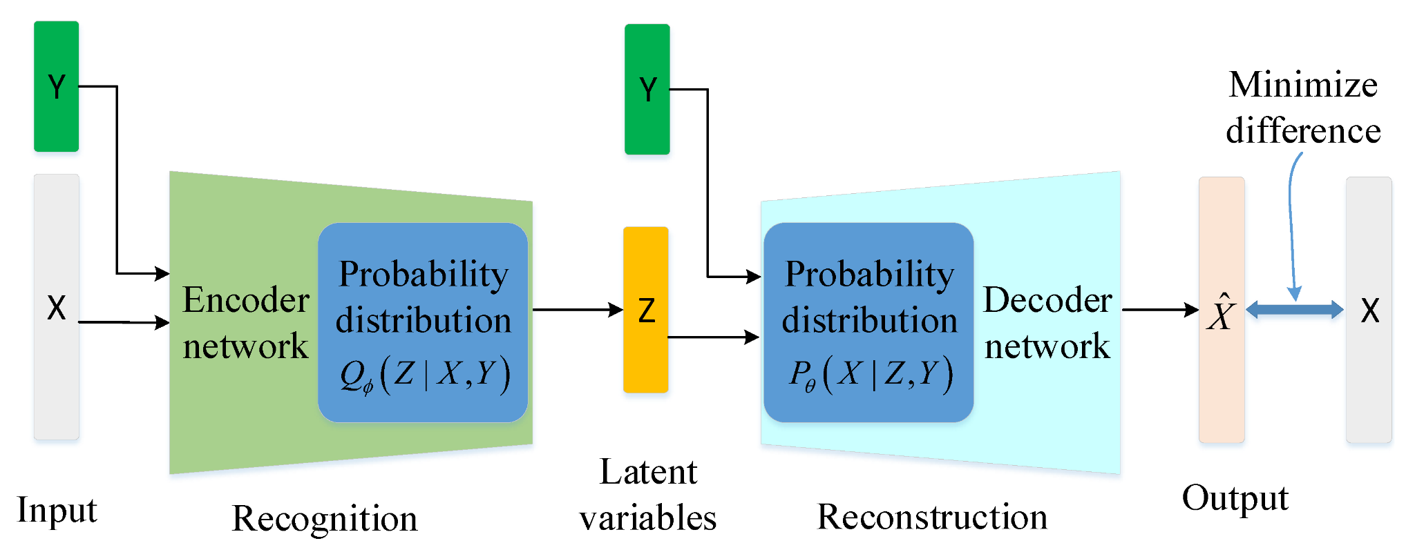
CS60092
Conditioning Encoder and Decoder of VAE with the label of either main-class or sub-class category
Notes:
To further enhance information we can condition both encoder and decoder with label.
We followed same training, extraction and retrieval pipeline as mentioned in the paper with making modifications in model based on experiment.

Slide 25
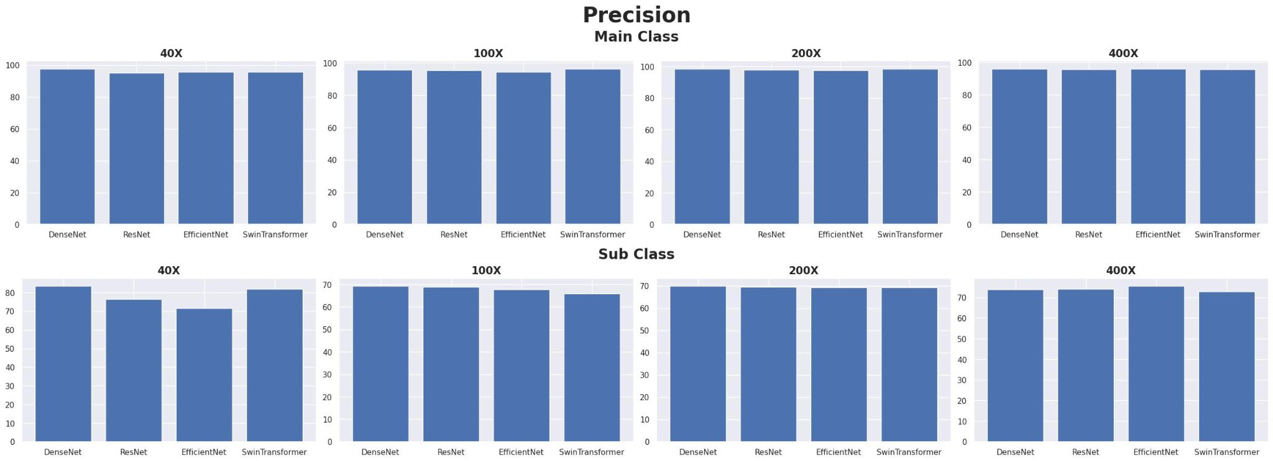
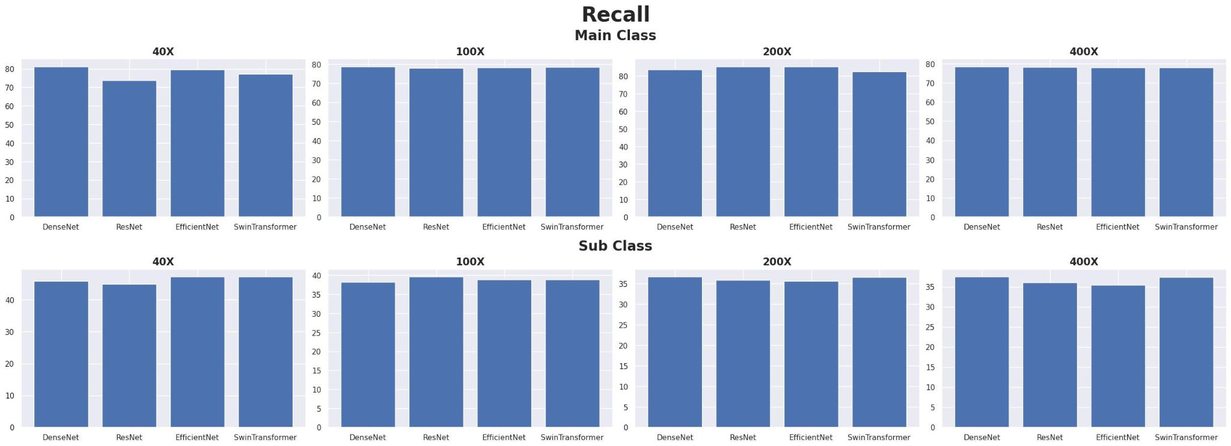
CS60092
Notes:
Figures shows precision and recall scores of different ImageNet encoders (Swin Transformer, ResNet, DenseNet, EfficientNet). All the encoders performed almost the same with slight difference in performance. By considering the average Precision and Recall for all the experiments varying class level and magnifications, DenseNet outperformed other ImageNet encoders.

Slide 26
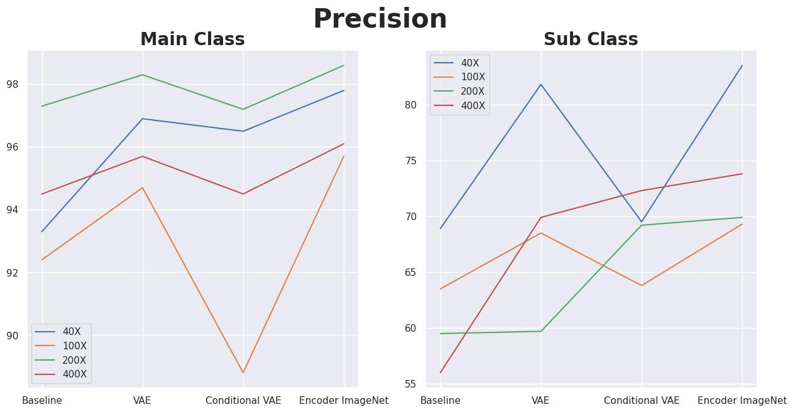
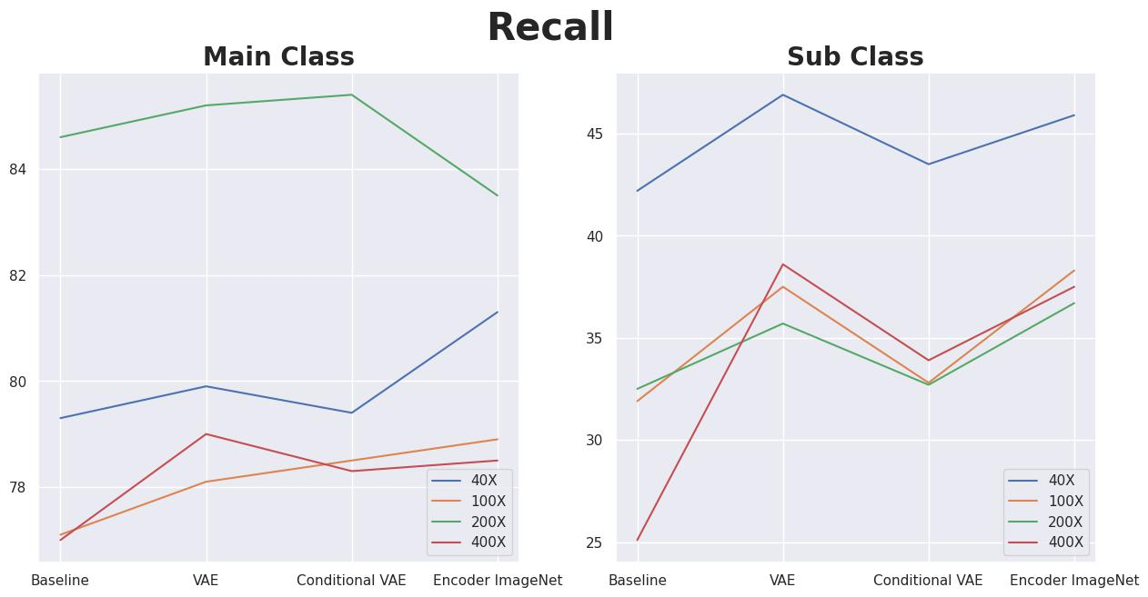
CS60092
Notes:
From Figures we can clearly see that for both main-class and sub-class level classifications irrespective of magnifications, ImageNet encoder approach gave best results in-terms of both Precision and Recall.

Slide 27
REFERENCES

Slide 28
CS60092
[1] Z. Liu et al., ‘Swin Transformer: Hierarchical Vision Transformer using Shifted Windows’, CoRR, vol. abs/2103.14030, 2021.
[2] G. Huang, Z. Liu, and K. Q. Weinberger, ‘Densely Connected Convolutional Networks’, CoRR, vol. abs/1608.06993, 2016.
[3] K. He, X. Zhang, S. Ren, and J. Sun, ‘Deep Residual Learning for Image Recognition’, CoRR, vol. abs/1512.03385, 2015.
[4] D. P. Kingma and M. Welling, ‘Auto-Encoding Variational Bayes’, arXiv [stat.ML]. 2022.
[5] A. E. Minarno, K. M. Ghufron, T. S. Sabrila, L. Husniah, and F. D. S. Sumadi, ‘CNN Based Autoencoder Application in Breast Cancer Image Retrieval’, in 2021 International Seminar on Intelligent Technology and Its Applications (ISITIA), 2021, pp. 29–34.
[6] L. Wei, Y. Yang, and R. M. Nishikawa, ‘Microcalcification classification assisted by content-based image retrieval for breast cancer diagnosis’, Pattern Recognition, vol. 42, no. 6, pp. 1126–1132, 2009.
[7] Y.-L. Huang, D.-R. Chen, and Y.-K. Liu, ‘Breast cancer diagnosis using image retrieval for different ultrasonic systems’, in 2004 International Conference on Image Processing, 2004. ICIP ’04., 2004, vol. 5, pp. 2957-2960 Vol. 5.
[8] R. S. Bressan, P. H. Bugatti, and P. T. M. Saito, ‘Breast cancer diagnosis through active learning in content-based image retrieval’, Neurocomputing, vol. 357, pp. 1–10, 2019.
[9] J. Zhou, C. Feng, X. Liu, and J. Tang, ‘A texture features based medical image retrieval system for breast cancer’, in 2012 7th International Conference on Computing and Convergence Technology (ICCCT), 2012, pp. 1010–1015.

Slide 29
THANK YOU

